Slide 1
ASSISTED LIVING PROJECT
RITWIK DUTTA

Slide 2
OVERVIEW OF CURRENT WORK
End user goes to the root website and clicks authorize
Frontend OAuth2 implementation flow redirects to Jawbone account login
Redirected temporary authentication token sent to server side Python CGI script
Script requests data from API by including Authentication tokens in the header
Script returns relevant data to JavaScript to be formatted and displayed

Slide 3
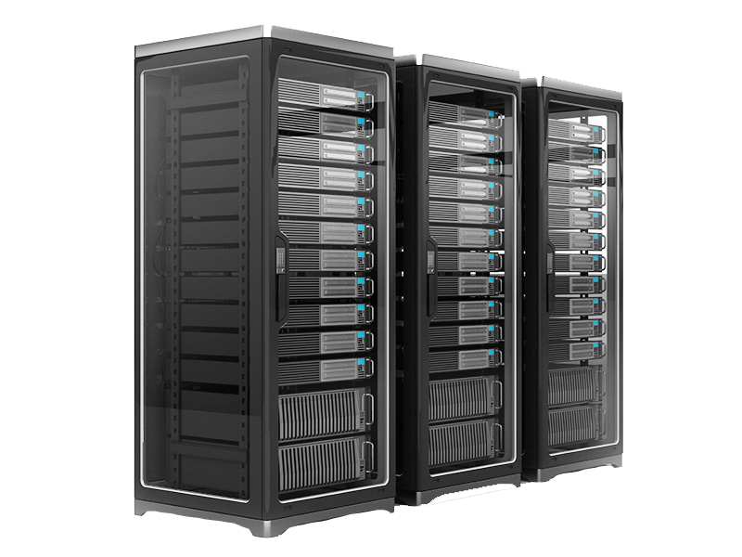
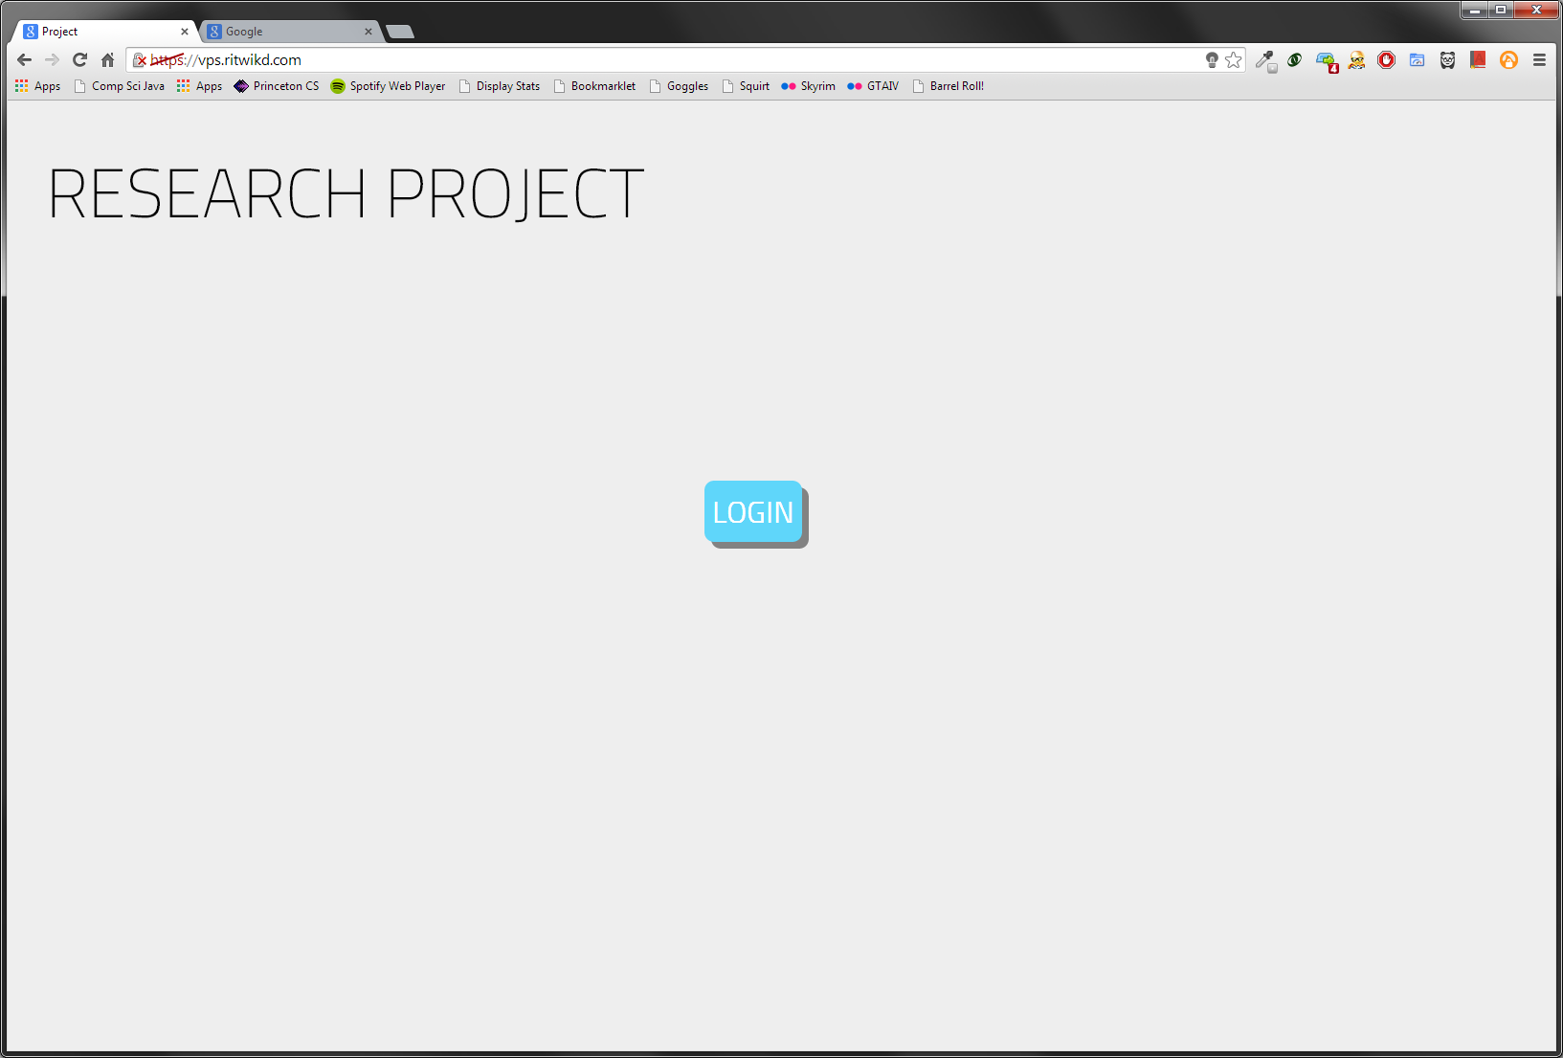
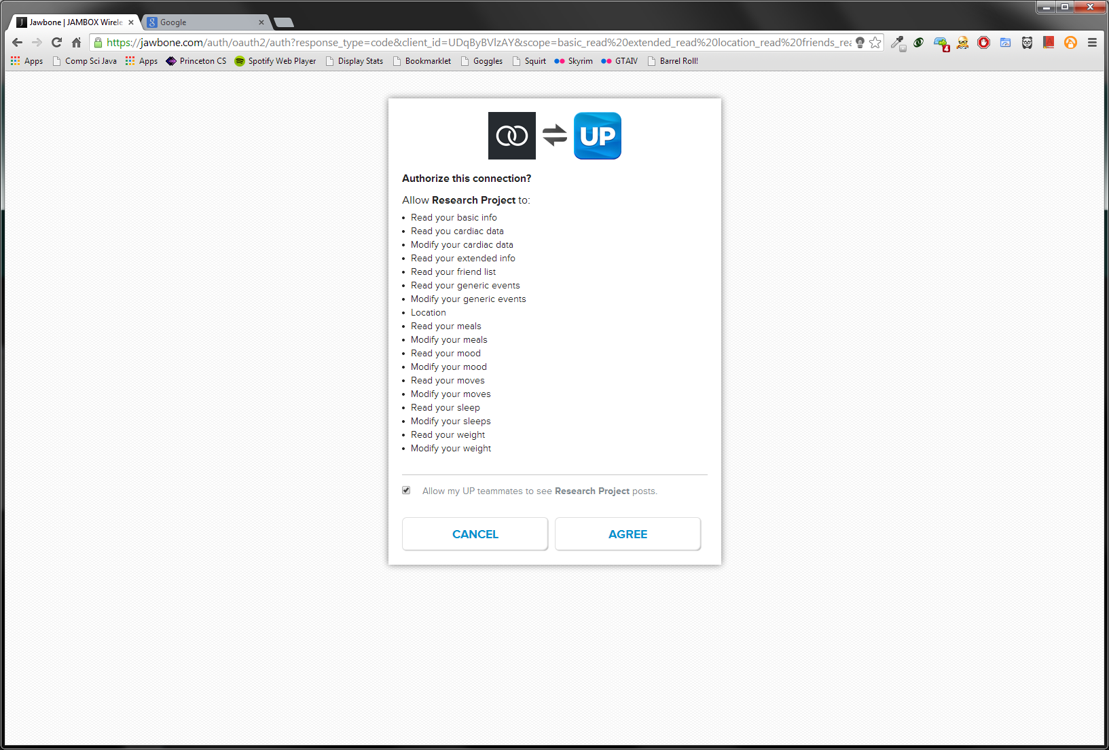


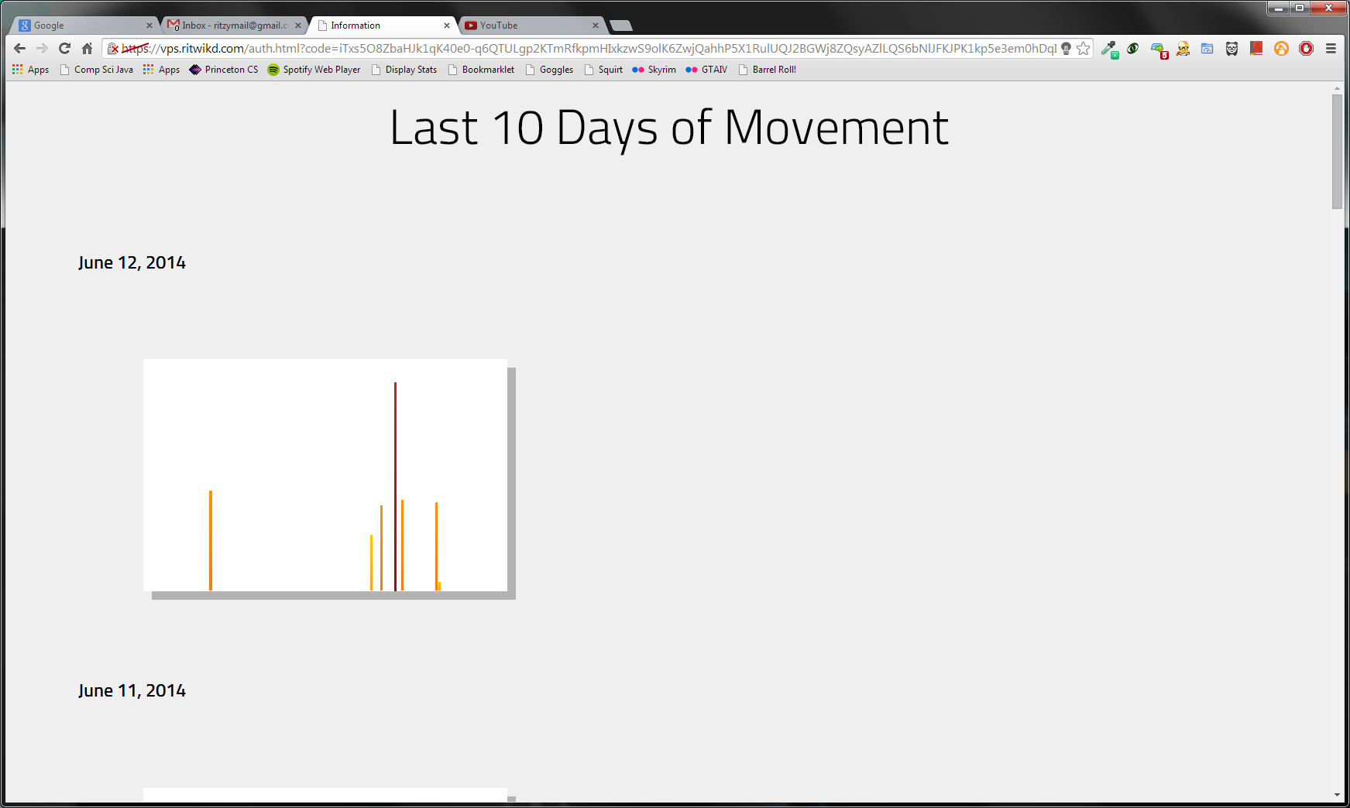
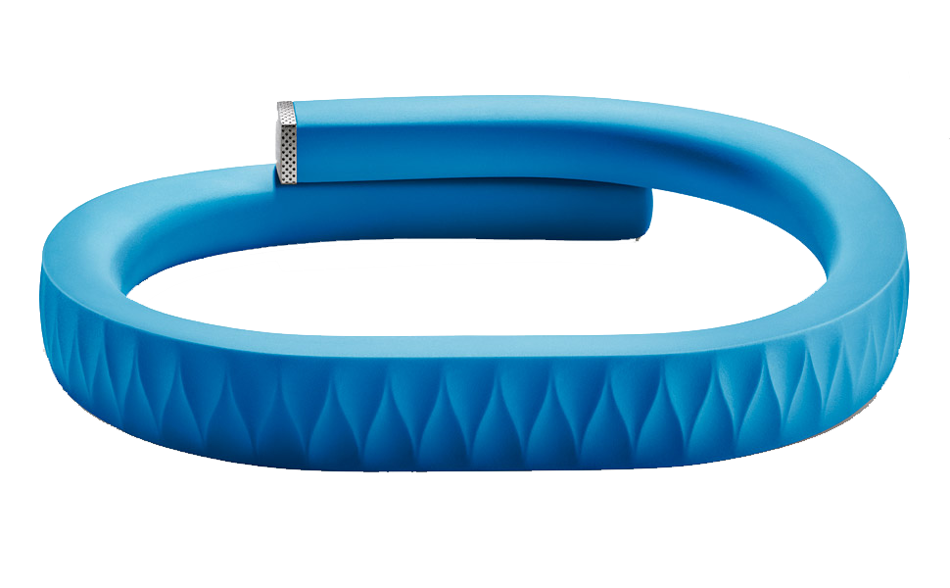
PROJECT FLOW
AUTHORIZE
CONNECTION
CARETAKER
PATIENT

Slide 4
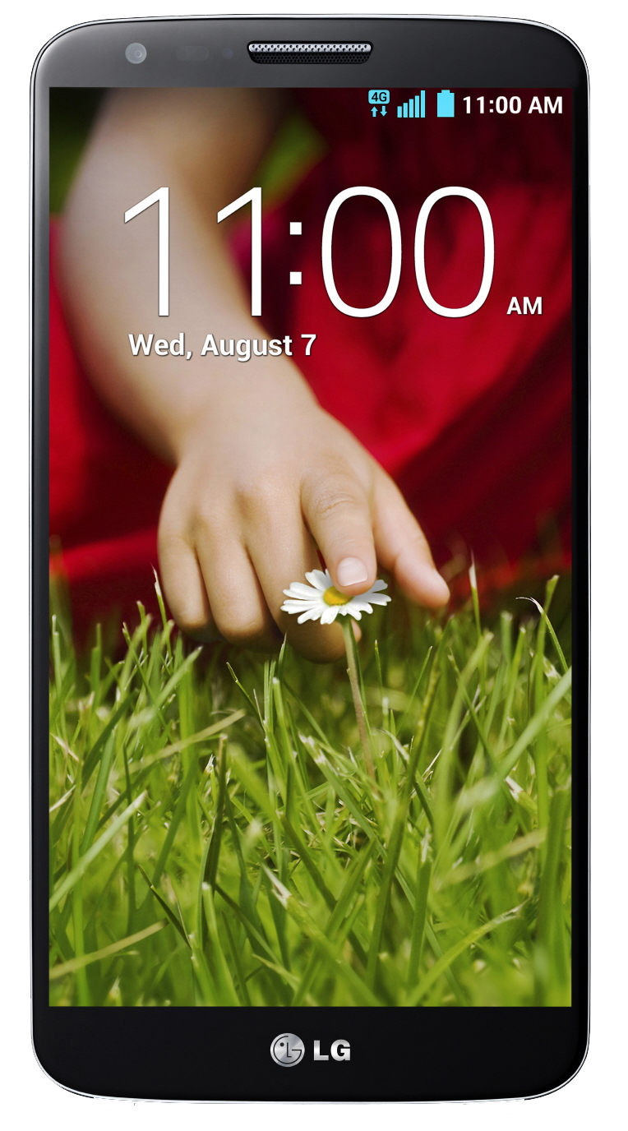
PATIENT SETUP
Patient wears Jawbone UP24 device on wrist
Patient carries smartphone in pocket
Wristband has an approximate battery life of 1 week
Phone has an approximate battery life of 12-15 hours (depending on model)
Data is synced every 20 minutes

Slide 5
CARETAKER SETUP
Caretaker needs to charge phone and band at daily and weekly intervals, respectively
Caretaker needs to manage Jawbone UP24 account
Caretaker needs to login to monitoring website

Slide 6
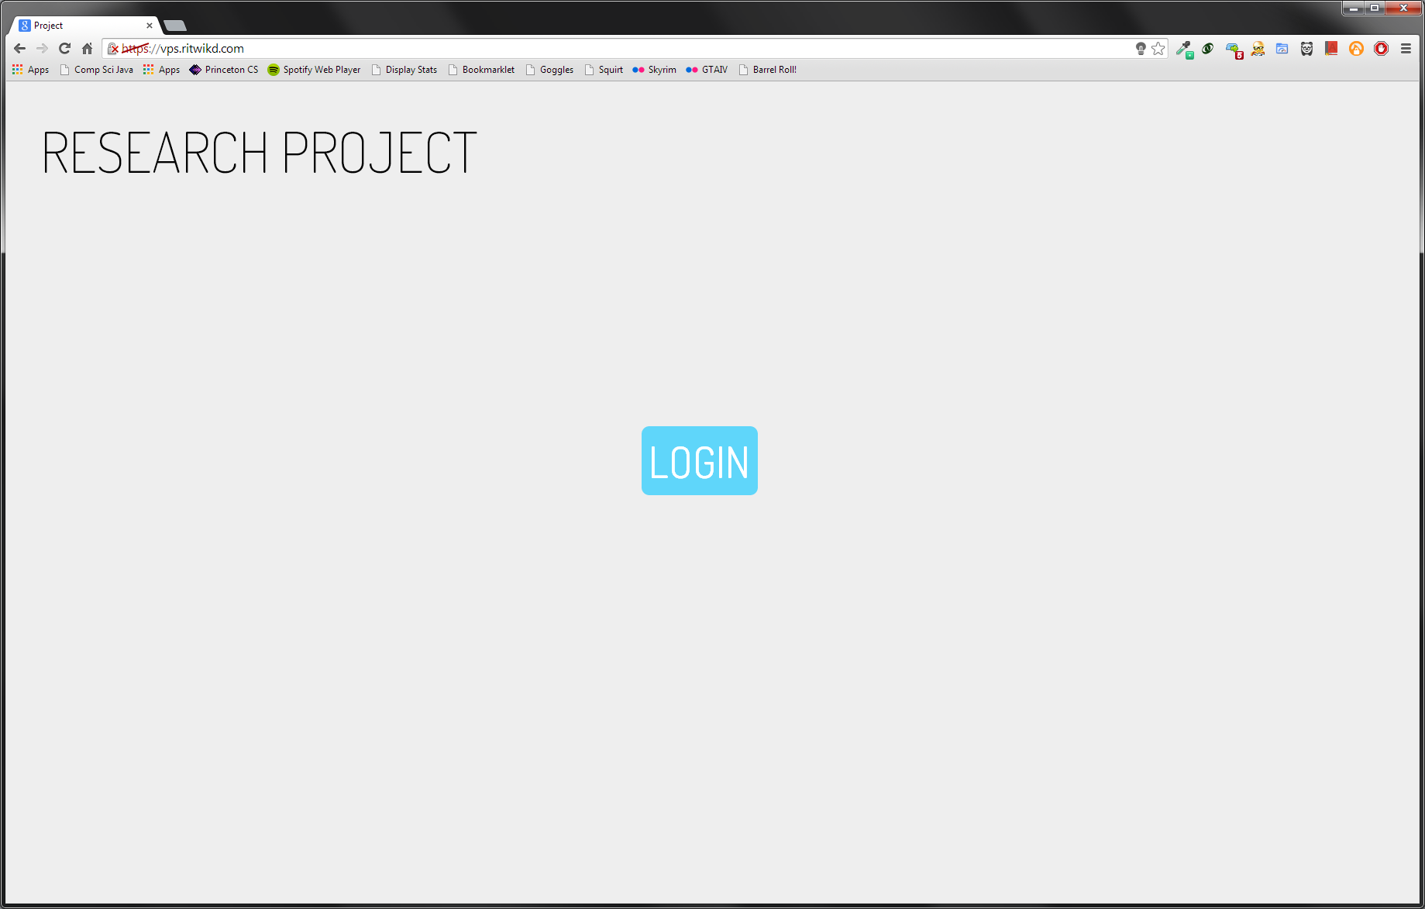
WEBSITE LOGIN – PART I
Simple interface
Single button, “LOGIN”
Redirects to Jawbone authentication page
Starts OAuth implementation flow

Slide 7
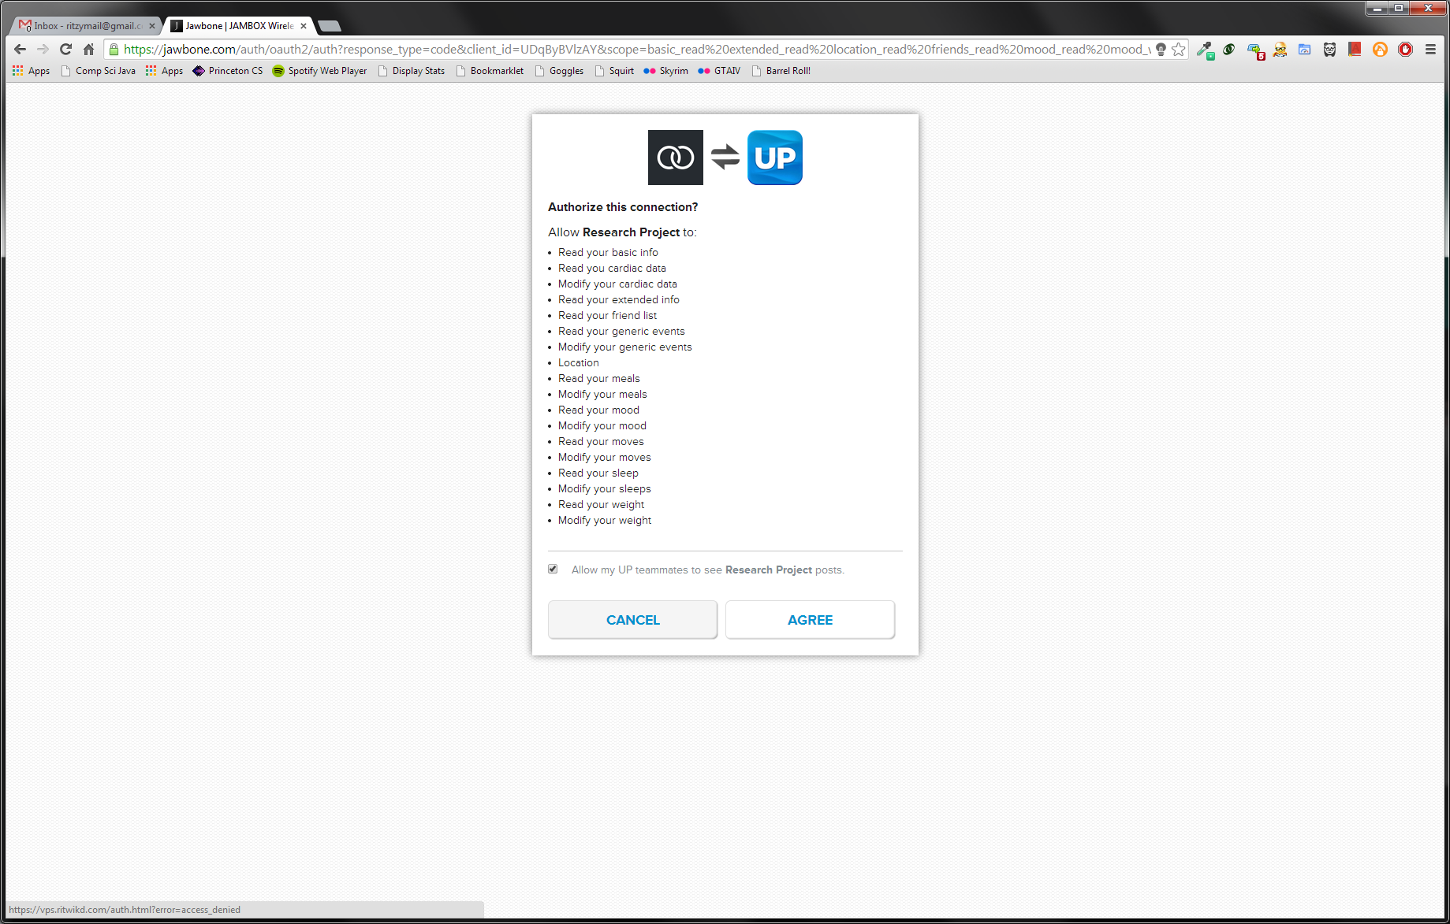
WEBSITE LOGIN – PART II
Jawbone authentication page
Requires Jawbone account
Returns temporary authentication token
Callback required to be https://
Current certificate self-generated
Not trusted by default

